Slide 1
Pokemon Gun
CSC 335: Group Project

Slide 2

Team
Denny
Mayank
Ryan
Zach

Slide 3
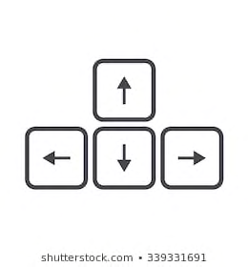


Premise
The Game is a top down shooter. You win when you kill the boss. You are already armed to the teeth with a pokeball projectile.
Controls are the Arrow Buttons for Movement, SpaceBar to Fire, and then Esc for the Menu.

Slide 4
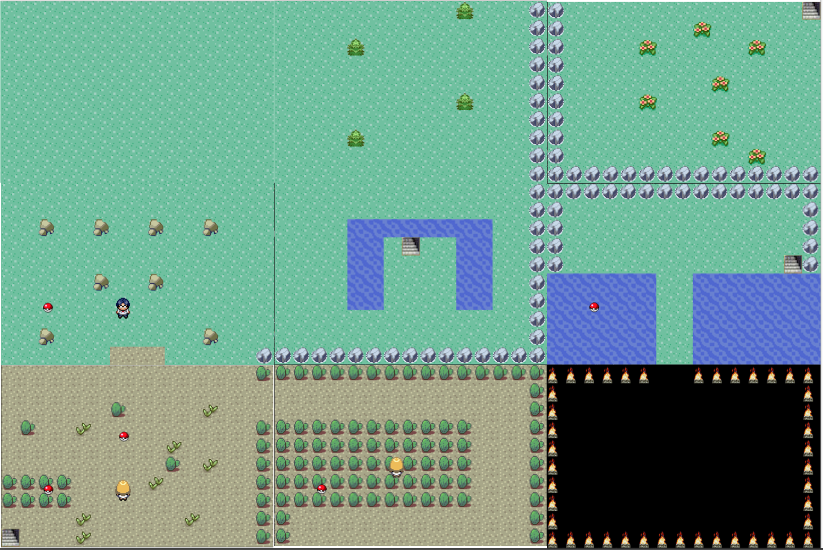
Various Stages
This is the general format of the world. The Stage that leads to the final boss room (colored in black) will change depending on whether the player has picked up the key.
There are also stairs that will lead the player to different parts of the map.
(2-2 Leads to 3-1)
(1-3 Leads to 3-2)
1-1
2-1
3-1
1-2
2-2
3-2
1-3
2-3
3-3

Slide 5



Items
Boots: Pick up Boots to run Faster
Heart: Pick up to regain Health
Key: Opens up the Map to the Final Boss

Slide 6



Enemies
Black Dragon: Moves rapidly around while moving towards you. Kill him to get the key.
Dude:
Shoots straight and rotates occasionally. But unit is stationary.
On Stage 2-2, the AI moves rotates based on where you are.
Lady: Moves around quickly while shooting

Slide 7
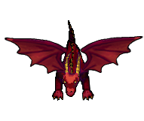
Wow Factor!
Boss: Moves in a Square and Shoots. And the boss has increased HP. And looks cool. Is also lightning fast.

